Slide 1
MSE – 803 – Data Analytics
Week 4 – Activities 1 & 2
World Happines
Andre Benedetti
09/05/2026

Slide 2
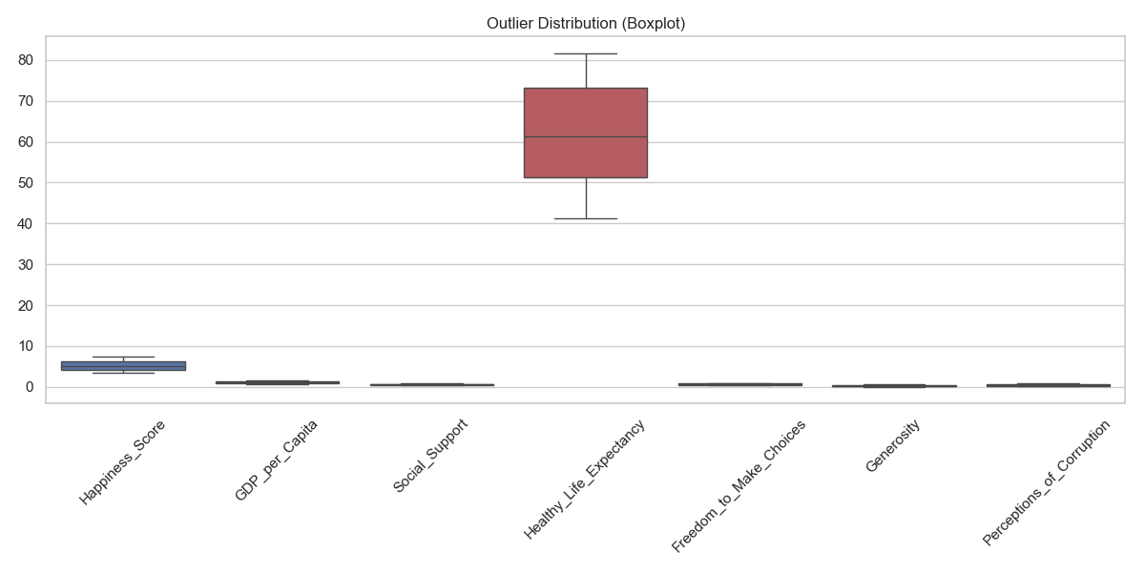
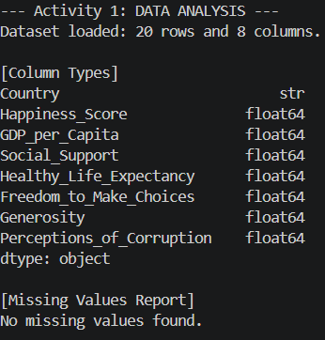
World Happines Dataset - Data Collection
Data Collection:
20 entries
8 Fields
No missing data our outliners

Slide 3
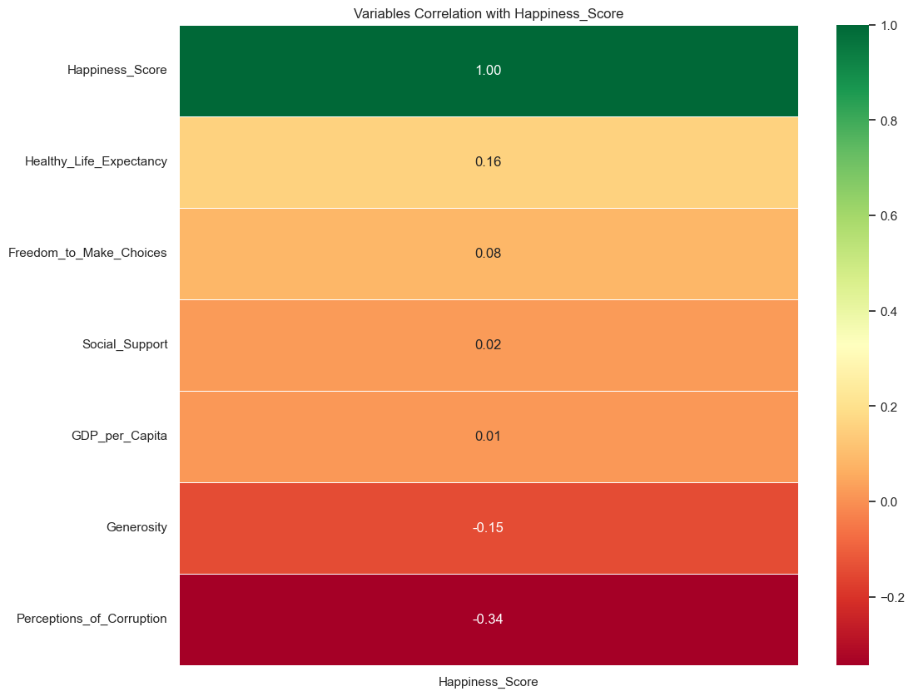
World Happines Dataset - Happiness correlation
Perception of corruption is the variable that most influences the happiness score.
The higher the perception of corruption, the lower the happiness score.
Life expectancy and generosity come next. While higher life expectancy leads to a higher happiness score, generosity negatively influences it.
GDP and social support have a very low correlation with the happiness score.

Slide 4
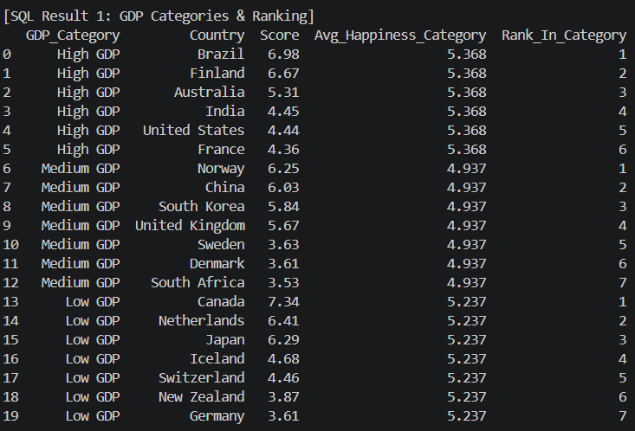
World Happines Dataset - GDP x Happiness
The countries were divided into 3 groups with an equivalent number of countries. Within each group, the countries were ranked and the average happiness was calculated.

Slide 5
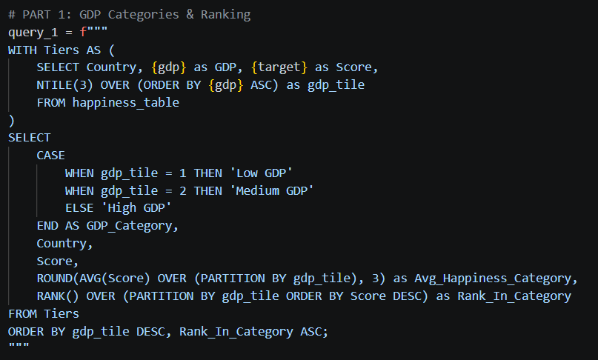
World Happines Dataset - GDP x Happiness
The countries were divided into 3 groups with an equivalent number of countries. Within each group, the countries were ranked and the average happiness was calculated.
The block 'WITH Tiers AS' selects GDP and NTILE(3) to divide the dataset into three tiers.
The 'CASE' block names each group, while the subsequent functions calculate the average happiness for each group and rank the countries within them.

Slide 6
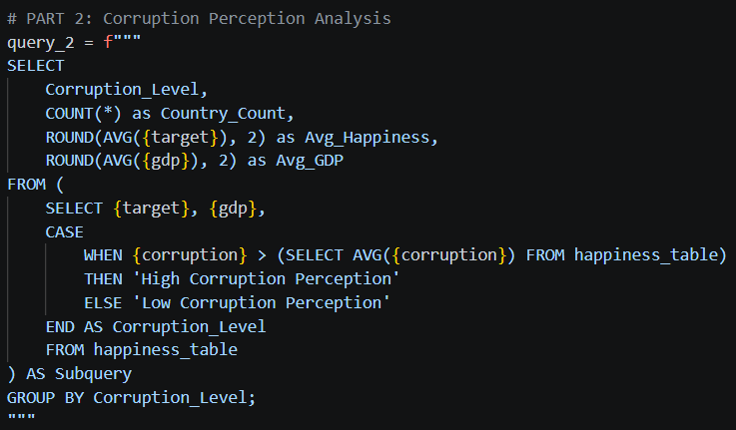

World Happines Dataset - GDP x Happiness
Countries were categorized into two groups based on their corruption perception levels. The average GDP and happiness score were then aggregated within each category to compare the results.
Conclusion: As shown by the correlation analysis and the SQL queries, corruption is the most influential factor on happiness, proving to be significantly stronger than wealth.

